Slide 1
Thermal Oxidation Of Silicon

Slide 2
Introduction
Oxidation is one of the key processes in the manufacture of silicon integrated circuits
SiO₂ is relatively easy to grow
It is an excellent insulator
It is an excellent diffusion barrier
It is stable at high temperatures
It is easily etchable

Slide 3
Silicon Dioxide
Good insulator -- Breakdown field 10MV/cm
  1000Å oxide will block 100V
  1000Å=100nm=1/100,000 of a cm
Very stable at high temperatures
  up to 1300C
A very good diffusion barrier
It is etchable
  Wet in HF
  Dry in Fluorine compounds

Slide 4
Oxide as a Diffusion Barrier
Dopant
Silicon Dioxide
Silicon

Slide 5
Oxide as an Implant Barrier
Implant Ions

Slide 6
Oxidation Mechanism
Dry Oxidation: the oxidising ambient is oxygen
  Si(solid) + O₂(gas) --------Heat-----> SiO₂ (solid)
Wet oxidation: the oxidising ambient is water vapour
  Si(solid) + H₂O(gas) ----Heat---> SiO₂ (solid) + 2H₂(gas)

Slide 7
Interface States
When the charge density between the oxide and the silicon is required to be low, thermal oxidation is the preferred technique (Silicon dioxide can also be formed by CVD deposition)
Typical oxidation temperatures
  800ºC -- 1200ºC
Typical gas flows for furnaces setup for 4” wafers 5/6 slpm

Slide 8
Wet or Dry Oxidation I
Oxides grown by dry oxidation
  in general have a lower trap density than those grown by wet oxidation
  the critical oxides in a MOS process are generally grown dry
  for example the Gate Oxide
  oxidation rates tend to be low

Slide 9
Wet or Dry Oxidation II
Oxides grown by wet oxidation
  the thicker oxides in the non-device areas of the circuits are grown wet
  for example field oxides
  these oxides tend to be thicker and can be grown quicker using wet oxidation techniques

Slide 10
Wet Oxides Vs Dry
(Oxidation Rate)
Part of the reason why wet oxidation is faster than dry oxidation is the concentration of the oxidising species (i.e. oxygen and water vapour) at typical oxidation temperatures
  at 1000^{ο}C
  O₂ = 5.2 X10¹⁶ /cm³
  H₂O = 3.0X10¹⁹/cm³
The concentration of water vapour is approximately 1000 times that of oxygen

Slide 11
OXIDATION
SILICON
Section of
silicon before
oxidation
Previous silicon
surface
SILICON DIOXIDE
Section of
silicon after
oxidation
SILICON

Slide 12
Silicon Consumed During Oxidation
The silicon in the silicon dioxide is provided by the wafer itself
This means some of the silicon is consumed during the oxidation process
The amount of silicon consumed is 0.44 times the thickness of oxide grown
  i.e. 1000nm of oxide growm
  440nm of silicon consumed

Slide 13
FURNACE SET-UP
Quartz
3 Heating Elements
Tube
Auto
Push/Pull
Cantilever
Paddle
Power
Supply
N O H
Gas Jungle
Computer

Slide 14
Typical Furnace Sequence
Step 1 Push in O₂ @ 800°C
Step 2 Ramp to 1000°C in O₂
Step 3 Dry oxidation 5 min in O₂ @ 1000°C
Step 4 Wet oxidation 1 hour (O_{2/}H₂) @ 1000°C
Step 5 Anneal in N₂ for 30 min @ 1000°C
Step 6 Ramp down to 800°C in N₂
Step 7 Pull in N₂

Slide 15
FURNACE CYCLE
Temp 800C
to 1000C
1000C
1000C
1000C
to 800C
800C
Gas O2
O2
O2
O2/H2
N2
N2
N2
Time 10min
20 min
5 min
1 hour
15 min
20 min
10 min
Cycle Push
Ramp
Dry
Wet
Anneal
Ramp
Pull

Slide 16
Temperature Control
The temperature of the furnace is one of the principle parameters in determining the oxidation thickness
Tight temperature control is critical for
  thickness control ⬇ across the batch
  across the wafer ⬇ batch to batch
Two sets of thermocouples are used, controlled by a computer algorithm

Slide 17
Temperature Control 2
Spike thermocouples
  Set outside the quartz tube between the windings of the furnace element
  Give a fast response to temperature changes
Profile thermocouples
  Inside the quartz tube in close proximity to the wafers
  Give an accurate representation of the actual temperature being seen by the wafers in the tube

Slide 18
Oxidation Model
Initially
Gas Ambient
Silicon
O2
X

Slide 19
Oxidation Model 2
Silicon
dioxide
Gas Ambient
Silicon
Co
O2
J
After Time t
Cs
Xo
X

Slide 20
Oxidising Molecules Diffusing through Oxide
OXYGEN
(Gas)
SILICON DIOXIDE
(Solid)
SILICON
(SOLID)
Diffusion of oxygen through silicon dioxide

Slide 21
Flux
Unit Area
Gas Particles
Particle Flow
Ficks Law States : The particle flow per unit area J (flux)
is directly proportional to the concentration gradient.

Slide 22
Mathematical Model
Derived from Ficks law
  J = D (dC/dx)
  J = flux
    the number of particles diffusing through unit area
  D = the diffusion coefficient (different for different diffusing molecules
  dC/dx = the concentration gradient
    Particles move from areas of high concentration to areas of low concentration

Slide 23
Mathematical Model
Based on this law and the reaction rate an equation can be derived relating the grown oxide thickness to time and temperature

Slide 24
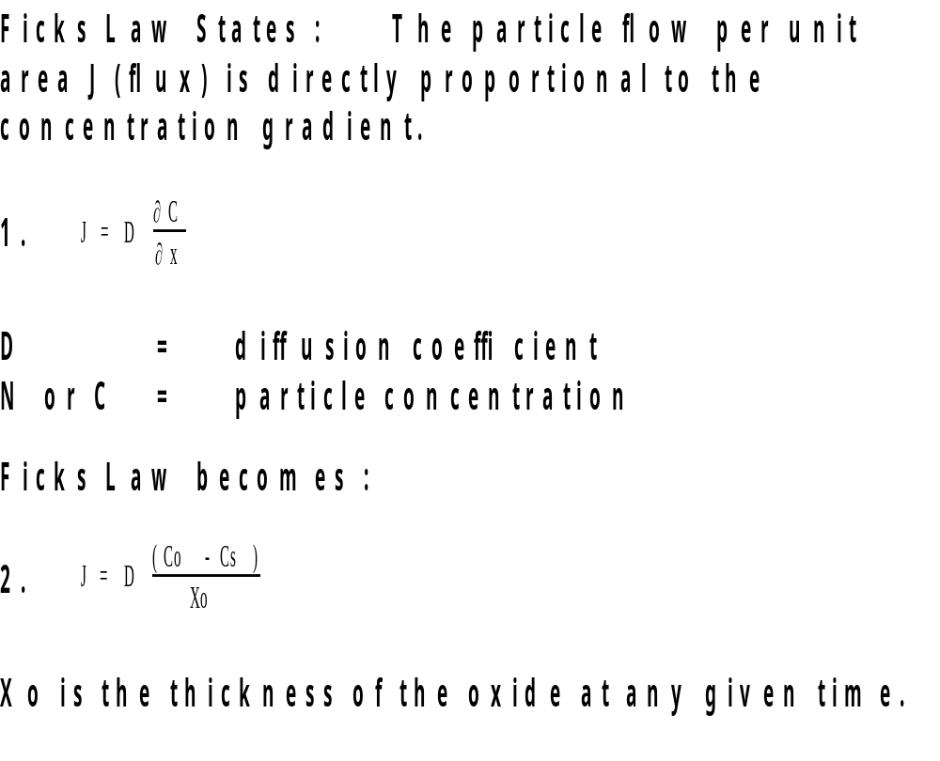
Ficks Law

Slide 25
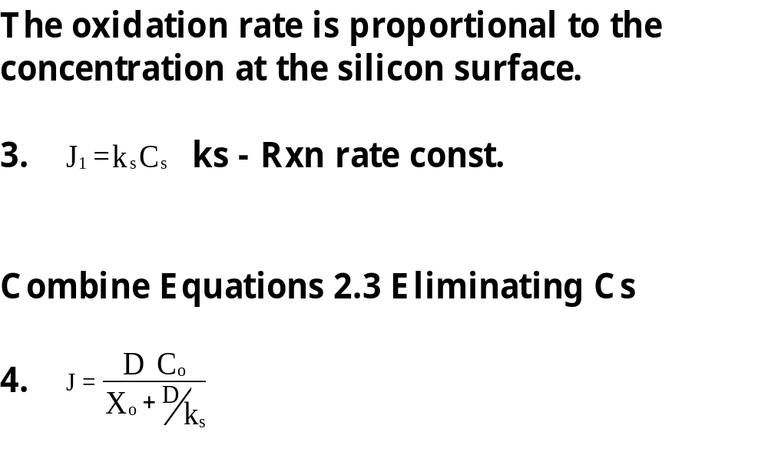
Oxidation Rate

Slide 26
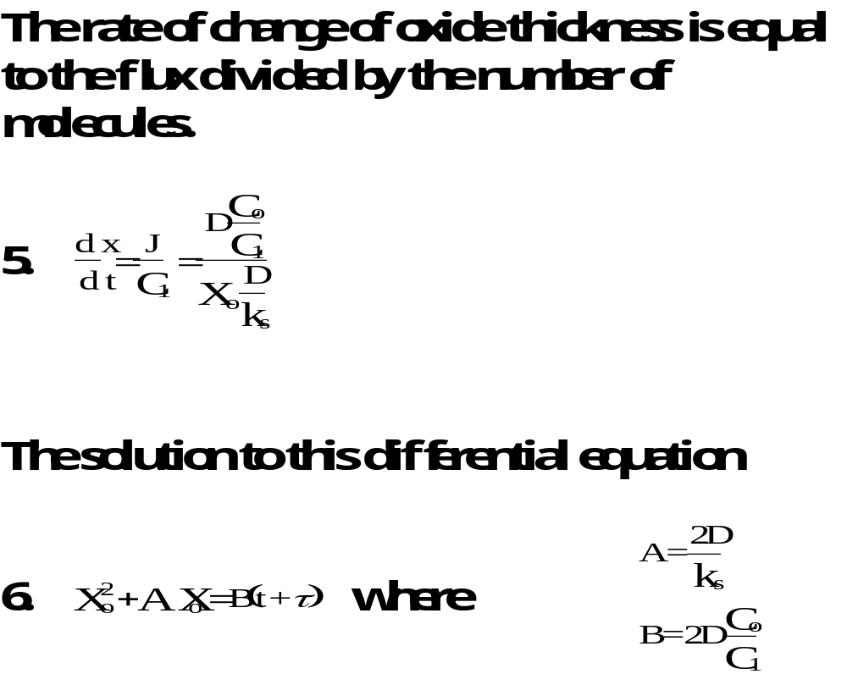
Rate of Change of Thickness

Slide 27
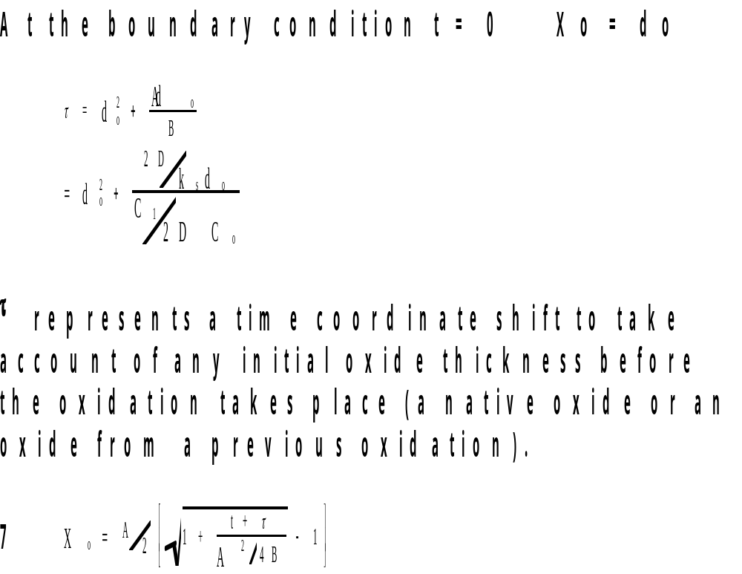
Oxidation Thickness Equation

Slide 28
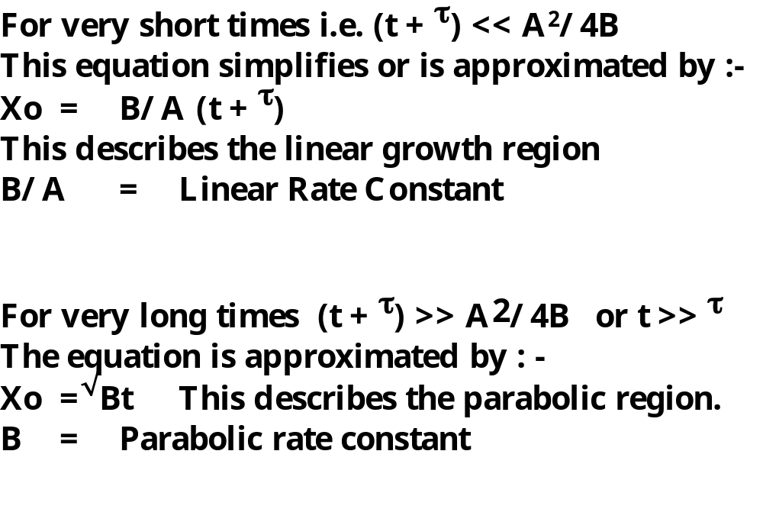
Approximations to Full Equation

Slide 29
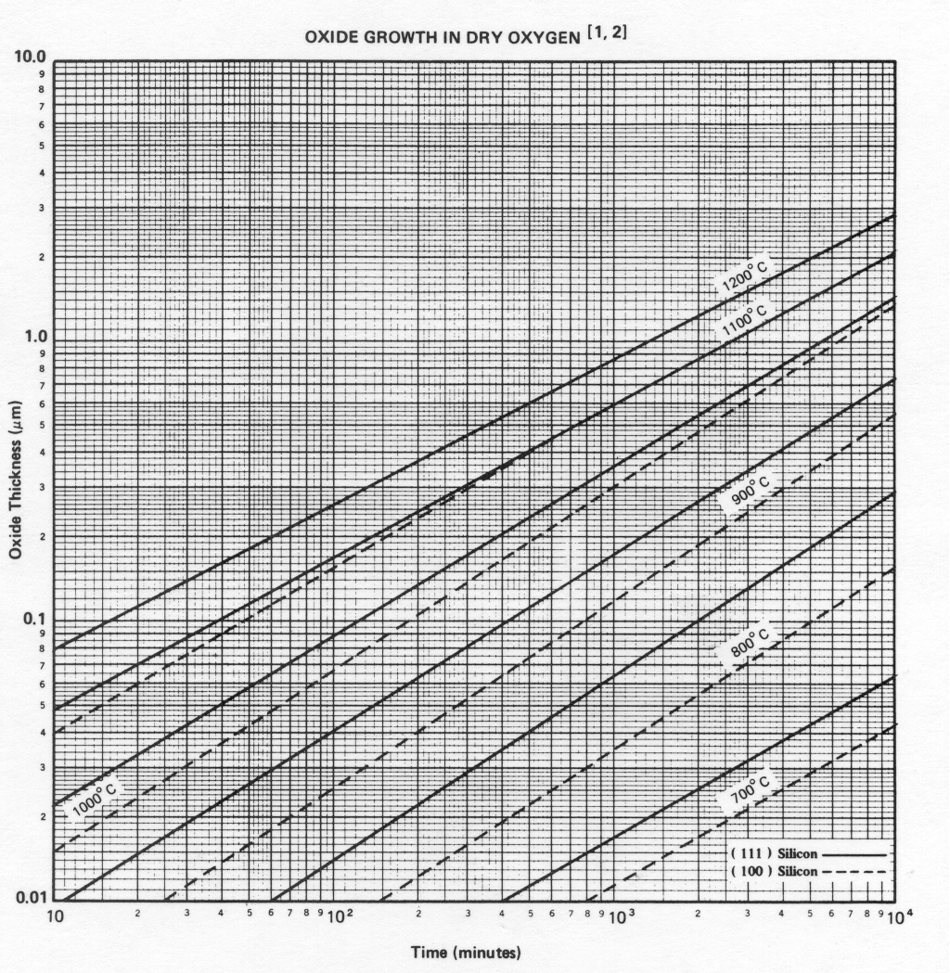
Dry Oxidation Plot

Slide 30
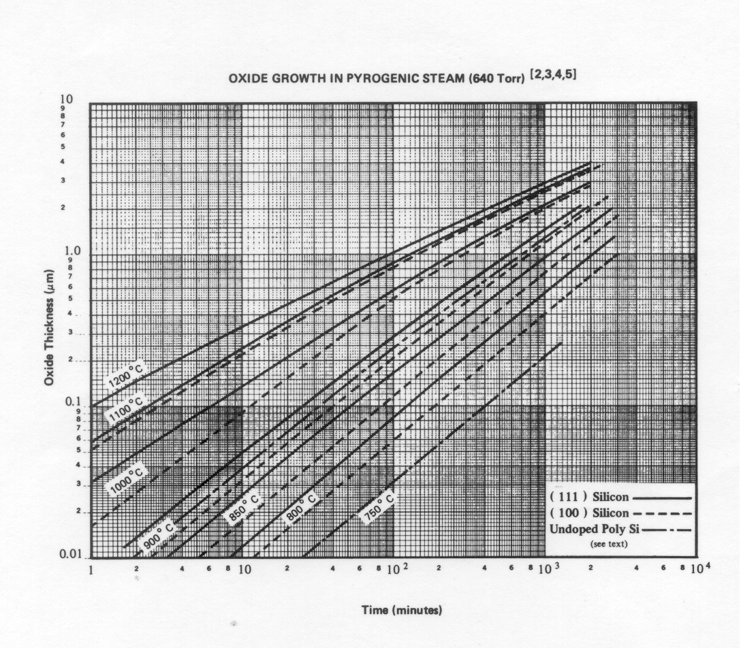
Wet Oxidation Plot

Slide 31
Oxides in the MOS Process
Initial Oxide
  implant barrier against subsequent implants
  or a diffusion barrier against furnace doping
Gate Oxide
  the most critical oxide in a MOS process
    plays a large part in setting the electrical characteristics
Field Oxides
  thick oxides in the non-device areas
  part of the isolation between devices
  in modern processes are formed as LOCOS oxides

Slide 32
Field Oxides
The LOCOS Process
Field oxides are formed using a LOCOS process
LOCOS
  Local Oxidation of Silicon
Silicon Nitride is used as a mask to prevent oxidation of the silicon in some areas
This gives a semi-recessed structure
  1µm of oxide with a step height of approximately half that

Slide 33
LOCOS or Semi Recessed Oxide
Silicon
Deposit Silicon Nitride
Grow Thin Oxide
Pattern with
Photoresist

Slide 34
Etch unprotected
nitride
Remove the Resist
Leaving nitride pad
on thin oxide

Slide 35
Grow the field oxide
Original thin oxide
Nitride forced up
at edges by
encroaching oxide
Active
Field Area
Area
Birds
Beak
Structure

Slide 36
Strip the nitride and the thin oxide
Active area
Semi-recessed
Field Oxide
Final LOCOS structure showing the birds beak,
so called because of the shape.

Slide 37
The final structure after the SAC and gate oxidations
Active
Field Area
Area
Birds
Beak
Structure

Slide 38
Traps
Traps are defects in the structure of the silicon dioxide at the atomic level
These defects can trap charge and raise the total charge level in the oxide
Processing conditions can reduce the level of traps in the oxide

Slide 39
Addition of Chlorine
Chlorine is often added in small quantities to the oxidising ambient to improve the overall quality of the oxides
  It improves the Dielectric strength of the oxide
  Helps to passivate against ionic sodium contamination
  Enhances minority carrier lifetime in the silicon

Slide 40
Methods of Introducing Chlorine
HCl
  low flow gas bleed into the furnace during oxidation
Trans-LC
  liquid source
  carrier gas bubbled through the liquid

Slide 41
Sodium Contamination in MOS Processes
MOS processes are particularly susceptible to ionic contamination from elements in the alkali metal group
Sodium is the main danger (Any alkali metal)
This contamination manifests itself as shifts in the threshold voltage under temperature stress

Slide 42
Prevention and Detection
Special handling precautions are needed to prevent contamination from humans to the furnace equipment
All chemicals in the process chain must have low alkali metal content
Water used in the cleaning process must have low ion content
Mobile ions incorporated in the oxides can be detected using stressed CV techniques

Slide 43
Stressed CV Measurement
By forming a capacitor using the thermal oxide as the dielectric and the silicon wafer as the lower plate of the capacitor the quality of the oxide can be assessed in terms of the quantity of charge incorporated in the oxide
The mobile ion content can be measured from one stress measurement

Slide 44
MOS Capacitor
Metal or Poly
Thermal Oxide
Silicon

Slide 45
Stress CV Cycle
Measure the CV at room temp, plot or save data
Apply +ve bias to the top plate of the capacitor, proportional to the oxide thickness ­ 1V/10nm
Heat the sample up to 250°C and hold for 3 min

Slide 46
Stress CV Cycle II
Cool the sample back to room temp
Re-measure the CV
Compare the two plots
The level of shift in the plots is a measure of the degree of contamination

Slide 47
Capacitance Vs Voltage Plot
C max
ΔV = shift
C
C min
-5V
Vt
Vfb
+5V
Capacitance versus Voltage Plot

Slide 48
Stressed CV Measurement II
The fixed charge can be monitored by recording the flat band voltage over time
Process conditions set the level of fixed charge
Contamination or absence of contamination sets the level of mobile charge

Slide 49
Fixed Charge
Fixed charge Qss
  contained within 20nm of the silicon /silicon dioxide interface
  the level of fixed charge is set by the processing conditions, temp, gas ambient
It is only the last high temp stage that the oxide “sees” which effects the Qss

Slide 50
Qss Triangle
E12
Dry Ox
Charge
Wet Ox
N2 Anneal
E11
500C 900C 1200C
Temperature

